Slide 1

CHAPTER 8
SQL Injection
Slides adapted from "Foundations of Security: What Every Programmer Needs To Know" by Neil Daswani, Christoph Kern, and Anita Kesavan (ISBN 1590597842; http://www.foundationsofsecurity.com). Except as otherwise noted, the content of this presentation is licensed under the Creative Commons 3.0 License.
Notes:
Welcome to SEC103 on Secure Programming Techniques. In this course, I assume that you have some background in computer security, but now you want to put that background to use. For example, in the Computer Security Principles and Introduction To Cryptography courses, we cover topics such concerning trust and encryption. In this course, we put these principles into to practice, and I’ll show you have to write secure code that builds security into your applications from the ground up.

Slide 2
Agenda
Command injection vulnerability - untrusted input inserted into query or command
  Attack string alters intended semantics of command
  Ex: SQL Injection - unsanitized data used in query to back-end database (DB)
SQL Injection Examples & Solutions
  Type 1: compromises user data
  Type 2: modifies critical data
  Whitelisting over Blacklisting
  Escaping
  Prepared Statements and Bind Variables

Slide 3
SQL Injection Impact in the Real World
CardSystems, credit card payment processing
Ruined by SQL Injection attack in June 2005
263,000 credit card #s stolen from its DB
#s stored unencrypted, 40 million exposed
Awareness Increasing: # of reported SQL injection vulnerabilities tripled from 2004 to 2005

Slide 4
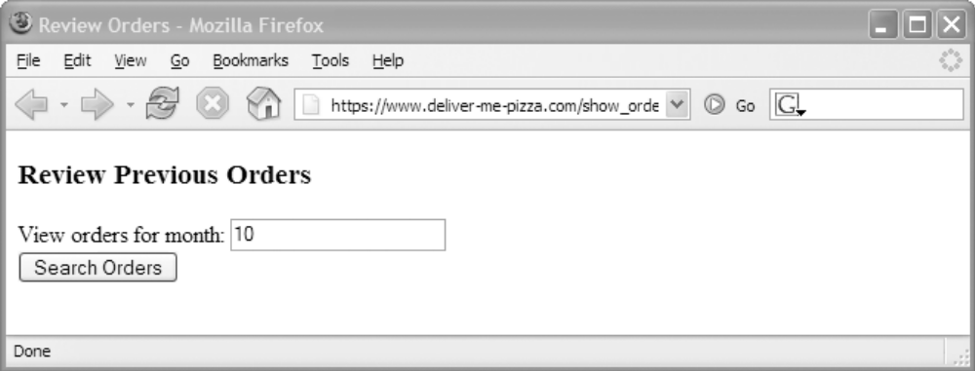
8.1. Attack Scenario (1)
Ex: Pizza Site Reviewing Orders
  Form requesting month # to view orders for
  HTTP request:
https://www.deliver-me-pizza.com/show_orders?month=10

Slide 5
8.1. Attack Scenario (2)
App constructs SQL query from parameter:
Type 1 Attack: inputs month='0 OR 1=1' !
Goes to encoded URL: (space -> %20, = -> %3D)
sql_query = "SELECT pizza, toppings, quantity, order_day " +
"FROM orders " +
"WHERE userid=" + session.getCurrentUserId() + " " +
"AND order_month=" + request.getParamenter("month");
Normal SQL Query
SELECT pizza, toppings, quantity, order_day
FROM orders
WHERE userid=4123
AND order_month=10
  https://www.deliver-me-pizza.com/show_orders?month=0%20OR%201%3D1

Slide 6
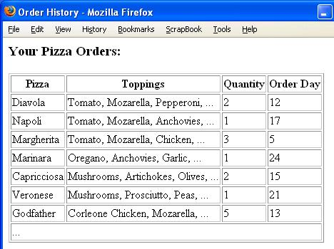
8.1. Attack Scenario (3)
Malicious Query
SELECT pizza, toppings, quantity, order_day
FROM orders
WHERE userid=4123
AND order_month=0 OR 1=1
WHERE condition is
always true!
  OR precedes AND
  Type 1 Attack:
  Gains access to
  other users’
  private data!
All User Data
Compromised

Slide 7
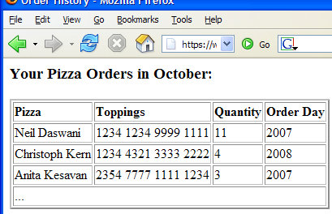
8.1. Attack Scenario (4)
More damaging attack: attacker sets month=
Attacker is able to
  Combine 2 queries
  1st query: empty
  table (where fails)
  2nd query: credit
  card #s of all users
0 AND 1=0
UNION SELECT cardholder, number, exp_month, exp_year
FROM creditcards

Slide 8
8.1. Attack Scenario (4)
Even worse, attacker sets
Then DB executes
  Type 2 Attack:
  Removes creditcards
  from schema!
  Future orders fail: DoS!
Problematic Statements:
  Modifiers: INSERT INTO admin_users VALUES ('hacker',...)
  Administrative: shut down DB, control OS…
month=0;
DROP TABLE creditcards;
SELECT pizza, toppings, quantity, order_day
FROM orders
WHERE userid=4123
AND order_month=0;
DROP TABLE creditcards;

Slide 9
8.1. Attack Scenario (5)
Injecting String Parameters: Topping Search
Attacker sets: topping=brzfg%'; DROP table creditcards; --
Query evaluates as:
  SELECT: empty table
  -- comments out end
  Credit card info dropped
sql_query =
"SELECT pizza, toppings, quantity, order_day " +
"FROM orders " +
"WHERE userid=" + session.getCurrentUserId() + " " +
"AND topping LIKE '%" + request.getParamenter("topping") + "%' ";
SELECT pizza, toppings, quantity, order_day
FROM orders
WHERE userid=4123
AND topping LIKE '%brzfg%';
DROP table creditcards; --%'

Slide 10
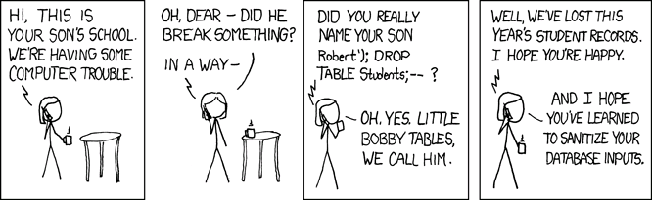
8.1. Attack Scenario (6)
Source: http://xkcd.com/327/

Slide 11
8.2. Solutions
Variety of Techniques: Defense-in-depth
Whitelisting over Blacklisting
Input Validation & Escaping
Use Prepared Statements & Bind Variables
Mitigate Impact

Slide 12
8.2.1. Why Blacklisting Does Not Work
Eliminating quotes enough (blacklist them)?
kill_quotes (Java) removes single quotes:
sql_query =
"SELECT pizza, toppings, quantity, order_day " +
"FROM orders " +
"WHERE userid=" + session.getCurrentUserId() + " " +
"AND topping LIKE
'kill_quotes(request.getParamenter("topping")) + "%'";
String kill_quotes(String str) {
StringBuffer result = new StringBuffer(str.length());
for (int i = 0; i < str.length(); i++) {
if (str.charAt(i) != '\'')
result.append(str.charAt(i));
}
return result.toString();
}

Slide 13
8.2.1. Pitfalls of Blacklisting
Filter quotes, semicolons, whitespace, and…?
  Could always miss a dangerous character
  Blacklisting not comprehensive solution
  Ex: kill_quotes() can’t prevent attacks against numeric parameters
May conflict with functional requirements
How to store O’Brien in DB if quotes blacklisted?

Slide 14
8.2.2. Whitelisting-Based Input Validation
Whitelisting – only allow input within well-defined set of safe values
  set implicitly defined through regular expressions
  RegExp – pattern to match strings against
Ex: month parameter: non-negative integer
  RegExp: ^[0-9]*$ - 0 or more digits, safe subset
  The ^, $ match beginning and end of string
  [0-9] matches a digit, * specifies 0 or more

Slide 15
8.2.3. Escaping
Could escape quotes instead of blacklisting
Ex: insert user o'connor, password terminator
  escape(o'connor) = o''connor
Like kill_quotes, only works for string inputs
Numeric parameters could still be vulnerable
sql = "INSERT INTO USERS(uname,passwd) " +
"VALUES (" + escape(uname)+ "," +
escape(password) +")";
INSERT INTO USERS(uname,passwd) VALUES ('o''connor','terminator');

Slide 16
8.2.4. Second-Order
SQL Injection (1)
Second-Order SQL Injection: data stored in database is later used to conduct SQL injection
  Common if string escaping is applied inconsistently
  Ex: o'connor updates passwd to SkYn3t
  Username not escaped, b/c originally escaped before entering DB, now inside our trust zone:
  Query fails b/c ' after o ends command prematurely
new_passwd = request.getParameter("new_passwd");
uname = session.getUsername();
sql = "UPDATE USERS SET passwd='"+ escape(new_passwd) +
"' WHERE uname='" + uname + "'";
UPDATE USERS SET passwd='SkYn3t' WHERE uname='o'connor'

Slide 17
8.2.4. Second-Order
SQL Injection (2)
Even Worse: What if user set
uname=admin'-- !?
  Attacker changes admin’s password to cracked
  Has full access to admin account
  Username avoids collision with real admin
  -- comments out trailing quote
All parameters dangerous: escape(uname)
  UPDATE USERS SET passwd='cracked' WHERE uname='admin' --'

Slide 18
8.2.5. Prepared Statements & Bind Variables
Metachars (e.g. quotes) provide distinction between data & control in queries
  most attacks: data interpreted as control
  alters the semantics of a query
Bind Variables: ? placeholders guaranteed to be data (not control)
Prepared Statements allow creation of static queries with bind variables
  Preserves the structure of intended query
  Parameters not involved in query parsing/compiling

Slide 19
8.2.5. Java Prepared Statements
PreparedStatement ps =
db.prepareStatement("SELECT pizza, toppings, quantity, order_day "
+ "FROM orders WHERE userid=? AND order_month=?");
ps.setInt(1, session.getCurrentUserId());
ps.setInt(2, Integer.parseInt(request.getParamenter("month")));
ResultSet res = ps.executeQuery();
Bind Variable:
Data Placeholder
Query parsed without parameters
Bind variables are typed: input must be of expected type (e.g. int, string)

Slide 20
8.2.5. PHP Prepared Statements
No explicit typing of parameters like in Java
Apply consistently: adding $year parameter directly to query still creates SQL injection threat
Have separate module for DB access
  Do prepared statements here
  Gateway to DB for rest of code
$ps = $db->prepare(
'SELECT pizza, toppings, quantity, order_day '.
'FROM orders WHERE userid=? AND order_month=?');
$ps->execute(array($current_user_id, $month));

Slide 21
8.2.5. SQL Stored Procedures
Stored procedure: sequence of SQL statements executing on specified inputs
Ex:
Vulnerable use:
Instead use bind variables w/ stored procedure:
CREATE PROCEDURE change_password
@username VARCHAR(25),
@new_passwd VARCHAR(25) AS
UPDATE USERS SET passwd=new_passwd WHERE uname=username
$db->exec("change_password '"+$uname+"','"+new_passwd+"'");
$ps = $db->prepare("change_password ?, ?");
$ps->execute(array($uname, $new_passwd));

Slide 22
8.2.6. Mitigating the Impact of SQL Injection Attacks
Prevent Schema & Information Leaks
Limit Privileges (Defense-in-Depth)
Encrypt Sensitive Data stored in Database
Harden DB Server and Host O/S
Apply Input Validation

Slide 23
8.2.6. Prevent Schema & Information Leaks
Knowing database schema makes attacker’s job easier
Blind SQL Injection: attacker attempts to interrogate system to figure out schema
Prevent leakages of schema information
Don’t display detailed error messages and stack traces to external users

Slide 24
8.2.6. Limiting Privileges
Apply Principle of Least Privilege! Limit
  Read access, tables/views user can query
  Commands (are updates/inserts ok?)
No more privileges than typical user needs
Ex: could prevent attacker from executing INSERT and DROP statements
  But could still be able do SELECT attacks and compromise user data
  Not a complete fix, but less damage

Slide 25
8.2.6. Encrypting Sensitive Data
Encrypt data stored in the database
  second line of defense
  w/o key, attacker can’t read sensitive info
Key management precautions: don’t store key in DB, attacker just SQL injects again to get it
Some databases allow automatic encryption, but these still return plaintext queries!

Slide 26
8.2.6. Hardening DB Server and Host O/S
Dangerous functions could be on by default
Ex: Microsoft SQL Server
  Allows users to open inbound/outbound sockets
  Attacker could steal data, upload binaries, port scan victim’s network
Disable unused services and accounts on OS (Ex: No need for web server on DB host)

Slide 27
8.2.6. Applying Input Validation
Validation of query parameters not enough
Validate all input early at entry point into code
Reject overly long input (could prevent unknown buffer overflow exploit in SQL parser)
Redundancy helps protect systems
  E.g. if programmer forgets to apply validation for query input
  Two lines of defense

Slide 28
Summary
SQL injection attacks are important security threat that can
  Compromise sensitive user data
  Alter or damage critical data
  Give an attacker unwanted access to DB
Key Idea: Use diverse solutions, consistently!
  Whitelisting input validation & escaping
  Prepared Statements with bind variables

